Slide 1
-
COVID-19 and The Crisis of the State and of the International Order -- Examples drawn from Haiti vs. The Democratic Confederalist Autonomous Administration Model
An Appeal to True Internationalist Solidarity
Paul Christian Namphy
.
-
“Mitigating COVID - and Protecting Human Rights - in the Global South Panel” , NYU, CHRGJ, May 13, 2020

Slide 2
-
Outline
1-Main objectives of UNAFFILIATED presentation
2-CoVid-19 epidemiological situation in Haiti
3-External and internal threats increasing the risk of the accelerate spread of CoViD-19 in Haiti
4-Actions on the ground of organizations in Haiti (state and non-state)--focus on the Water, Sanitation and Hygiene (WASH) sector
5-Comparative analysis (Haiti vs. AANES / Rojava) of international dynamics at play in shaping CoViD-19 outcomes
6-Conclusion / Acknowledgements
.

Slide 3
-
3 Main Presentation Objectives
Illustration that:
Gains in battle against CoVid due to advocacy and dedication
Role of CoViD-19 in pre-existing context of contradictions of the state, and of the international order, posing new challenges
Critical appeal must continue for solidarity with CoViD-19 populations of the Global South – from YOU!
.
Notes:
-In CoViD-19 crisis, it is the sheer dedication of committed women and men, and advocacy organizations expressing international solidarity, that has achieved the positive objectives that we have witnessed
-The contradictions of the State, and of the International Order, existing prior to the arrival of CoViD-19, are playing out currently, in new ways, and posing major challenges to survival and livelihood.
-International solidarity among universities and activist organizations is key to achieving positive outcomes (life-saving, promotion of well-being and dignified livelihoods) among CoViD-19 populations of the Global South – and in your own communities

Slide 4
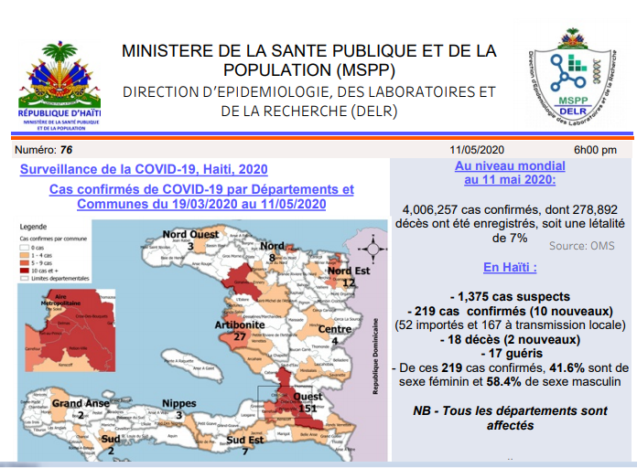
-
Haiti CoViD-19 Incidence through May 12, 2020
219 confirmed cases, 18 deaths, exponential curve rise NOW
.
.
Notes:
-In CoViD-19 crisis, it is the sheer dedication of committed women and men, and advocacy organizations expressing international solidarity, that has achieved the positive objectives that we have witnessed
-The contradictions of the State, and of the International Order, existing prior to the arrival of CoViD-19, are playing out currently, in new ways, and posing major challenges to survival and livelihood.
-International solidarity among universities and activist organizations is key to achieving positive outcomes (life-saving, promotion of well-being and dignified livelihoods) among CoViD-19 populations of the Global South – and in your own communities

Slide 5
-
EXTERNAL Threats From CoViD-19 to life and to well-being in Haiti
CoViD-19 Infections from the OUTSIDE of Haiti?
CoViD-19 originally came from outside Haiti in the 1st place
1-land border crossings (where the Haitian state is so far non-existent), (and some sea travelers)
and 2-entry of CoViD-19 individuals on flights (including deportation flights from the US).
Efforts from committed individuals are underway to mitigate both threats.
.
Notes:
-In CoViD-19 crisis, it is the sheer dedication of committed women and men, and advocacy organizations expressing international solidarity, that has achieved the positive objectives that we have witnessed
-The contradictions of the State, and of the International Order, existing prior to the arrival of CoViD-19, are playing out currently, in new ways, and posing major challenges to survival and livelihood.
-International solidarity among universities and activist organizations is key to achieving positive outcomes (life-saving, promotion of well-being and dignified livelihoods) among CoViD-19 populations of the Global South – and in your own communities

Slide 6
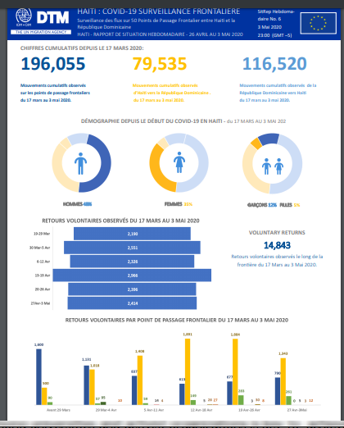
Quantitative Land Crossing Numbers: 116,520 returns of Haitians from Dom.Rep.to Haiti, 3/17-5/3
.
Notes:
-In CoViD-19 crisis, it is the sheer dedication of committed women and men, and advocacy organizations expressing international solidarity, that has achieved the positive objectives that we have witnessed
-The contradictions of the State, and of the International Order, existing prior to the arrival of CoViD-19, are playing out currently, in new ways, and posing major challenges to survival and livelihood.
-International solidarity among universities and activist organizations is key to achieving positive outcomes (life-saving, promotion of well-being and dignified livelihoods) among CoViD-19 populations of the Global South – and in your own communities

Slide 7
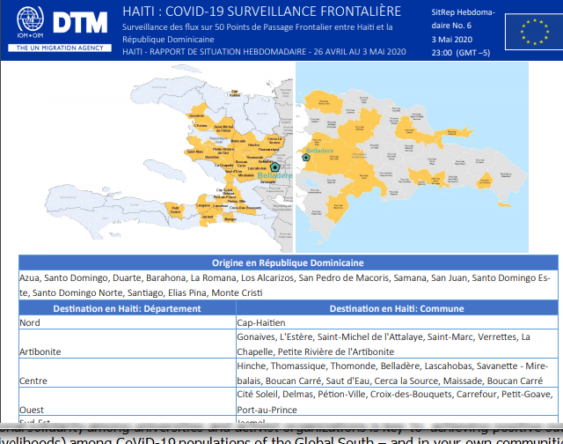
-
Individual traffic: throughout DR to Haiti’s main pop. centers
.
.
.
Notes:
-In CoViD-19 crisis, it is the sheer dedication of committed women and men, and advocacy organizations expressing international solidarity, that has achieved the positive objectives that we have witnessed
-The contradictions of the State, and of the International Order, existing prior to the arrival of CoViD-19, are playing out currently, in new ways, and posing major challenges to survival and livelihood.
-International solidarity among universities and activist organizations is key to achieving positive outcomes (life-saving, promotion of well-being and dignified livelihoods) among CoViD-19 populations of the Global South – and in your own communities

Slide 8
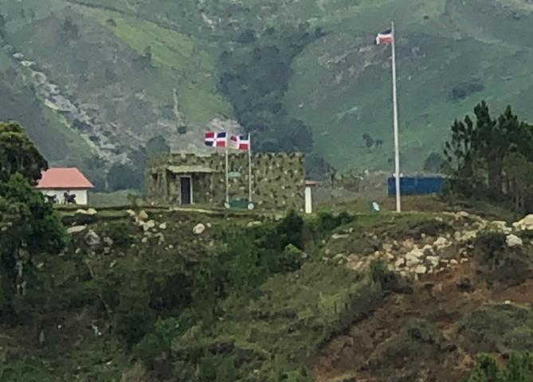
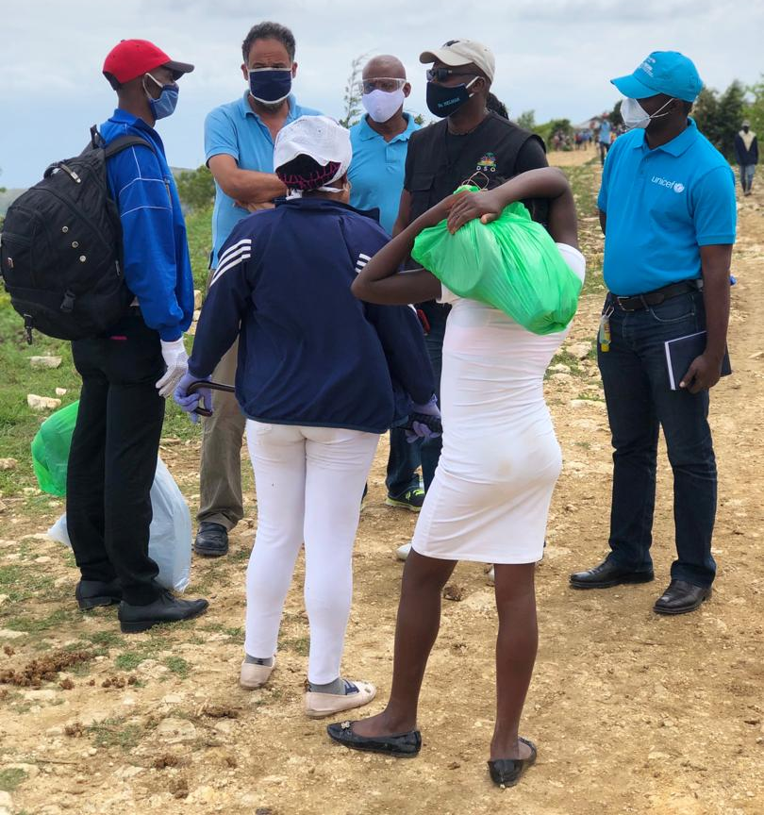
-
.
BORDER ASSYMETRY!
Savane Bombe, Cornillon informal border crossing
ARMORED DOMINICAN BORDER BARRACKS VS… a few of us!!
.
.
VS.
Notes:
-In CoViD-19 crisis, it is the sheer dedication of committed women and men, and advocacy organizations expressing international solidarity, that has achieved the positive objectives that we have witnessed
-The contradictions of the State, and of the International Order, existing prior to the arrival of CoViD-19, are playing out currently, in new ways, and posing major challenges to survival and livelihood.
-International solidarity among universities and activist organizations is key to achieving positive outcomes (life-saving, promotion of well-being and dignified livelihoods) among CoViD-19 populations of the Global South – and in your own communities

Slide 9
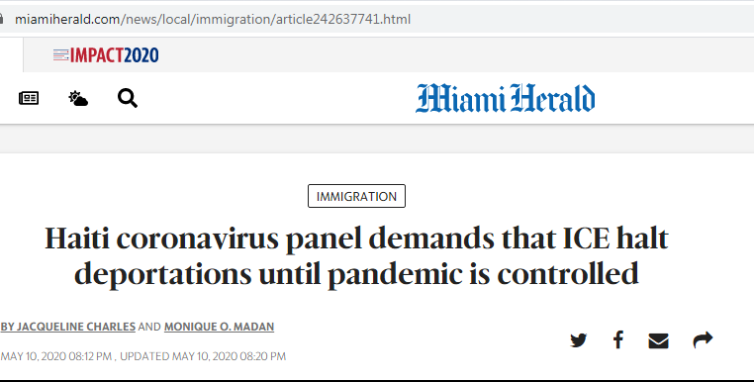
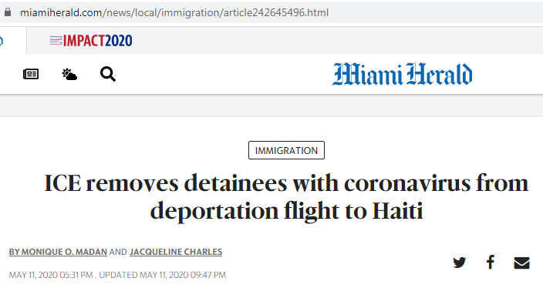
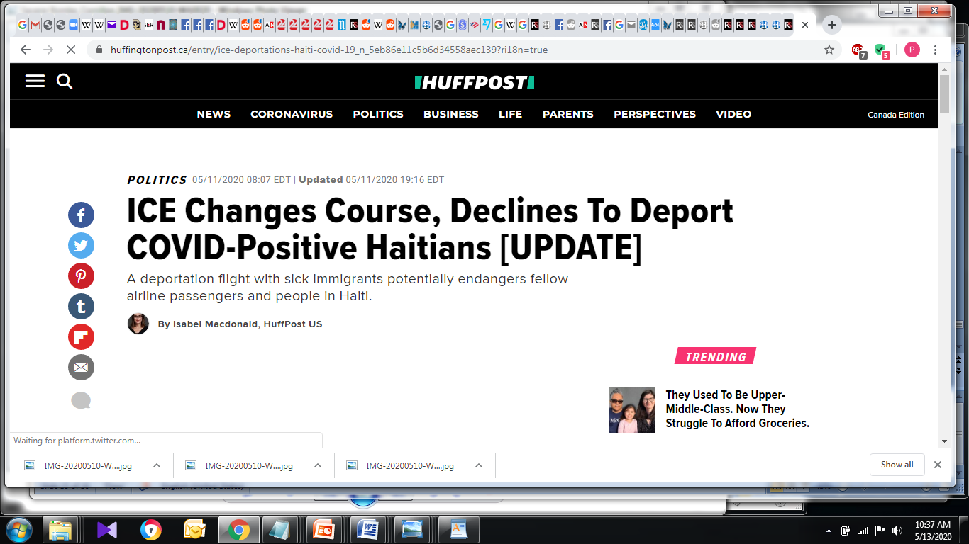
-
Advocacy Victory –
Air risk
KUDOS to IJDH!
Deportation threat from ICE
>100 Haitians back to Haiti
Monday 5/11/2020
SOME deportees CoViD-19 positive (>=5)
ADVOCACY WIN
Removal of all known CoViD-19 positive individuals from flight roster (and some others)
Haitian governmental panel’s call
to stop deportation flights during CoViD-19.
.
Notes:
Case In point – advocacy successful in stopping ICE (Trump Administration deportation unit) from sending a mixed roster of CoViD-19 positive
and non-infected passengers (over 100 in all). End results after days of phone calls and heart-stopping pleas, mainly from IJDH:
1-Numbers of passengers on flight roughly cut in half
2-All passengers who had tested positive for CoViD-19 (at least 5) removed from flight list
3-Haitian governmental panel's call for moratorium on all future deportation flights during the CoViD-19 crisis

Slide 10
-
INTERNAL Threats From CoViD-19 to life and to well-being in Haiti
Lack of in-country preparedness (risk)
Facemasks? practiced by SOME, physical distancing? practiced by SOME
Resistance. Why?: a-survival, b-lack of awareness (less), c-lack of truly believing there is a threat, despite messaging (more often)
Full Contact tracing – now impossible due to disease spreading (including domestic transmission) + limited resources.
.
Notes:
Country not well-prepared to stop person-to-person transmission within in the country
Wearing of facemasks practiced by SOME, social distancing practiced by SOME
Resistance to social distancing: a-survival, b-lack of awareness, of, more often, lack of truly believing there is a threat, despite messaging
Full Contact tracing has become nearly impossible at this point, due to disease spreading (including domestic infections) and limited resources.

Slide 11
-
CoViD-19 WASH INTERVENTIONS
3-Pronged strategy
1-WASH/Health coordinating CoViD-19 sensitization campaigns, sound trucks / megaphones, key messages, hand-washing stations with water/soap.
2-WASH in >40 health care facilities opening up
3-Improved WASH access in geographic priority areas (some low cost, rural border areas)
.
Notes:
Haiti is implementing 3-pronged strategy:
1-wash and health coordinating sensitization campaign, with sound trucks, individuals with megaphones,
hammering home key messages, juxtaposed with hand-washing stations with hygiene promoters, which are regularly supplied with water and soap.
2-Coordination of the water and sanitation component of CoViD-19 care facilities (over 40 opened or soon to be opened throughout Haiti,
targeting 7500-9000 beds in preparation for a case spike).
3-improved water (and, phased in, sanitation) access in geographically priority areas... particularly at rural border localities,
which can have important improvements at low cost, quickly implemented.
Consistent with observations made in forums (ex: WASH / CoViD-19 forums, World Bank, IADB, etc…) – conclusion that approach must be tailored to Global South’s reality in order to be effective

Slide 12
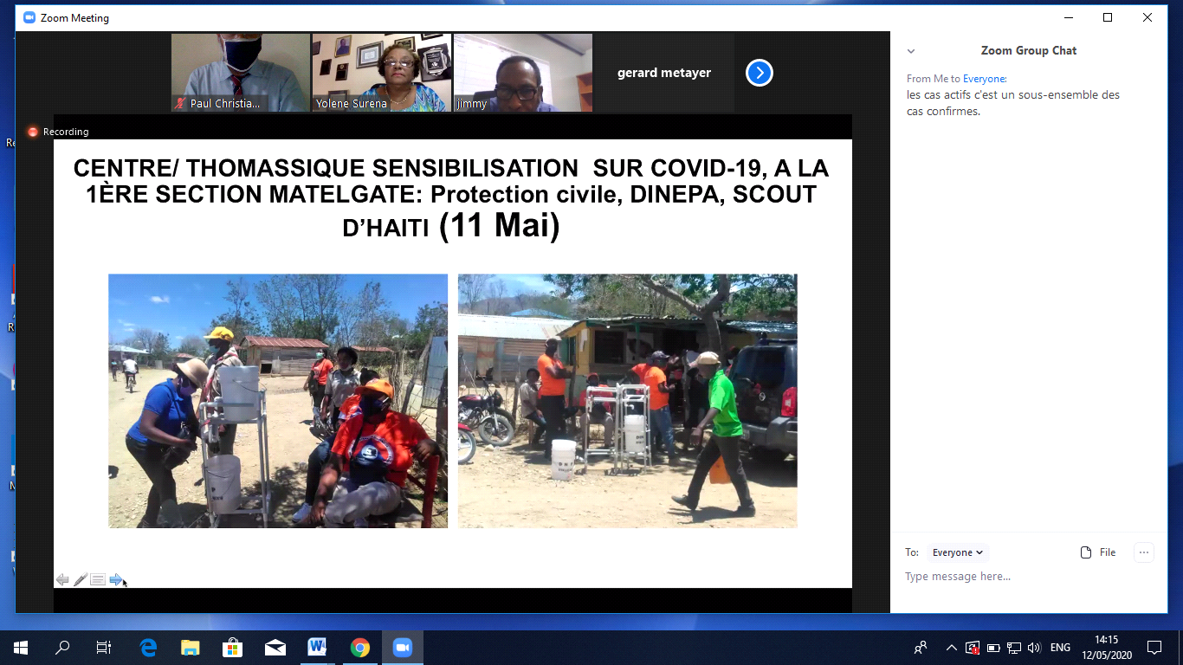
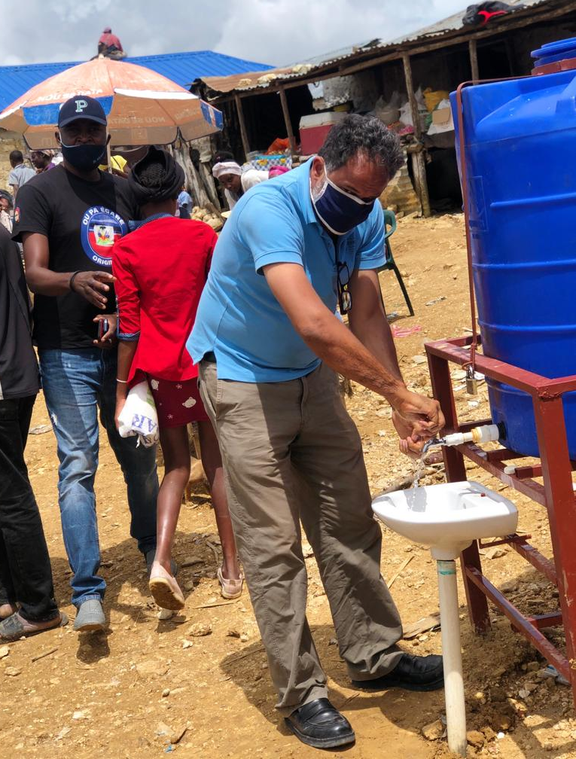
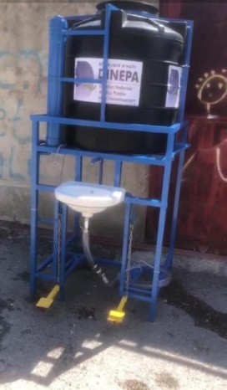
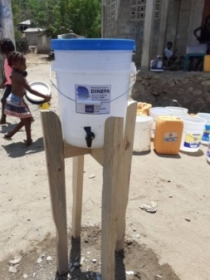
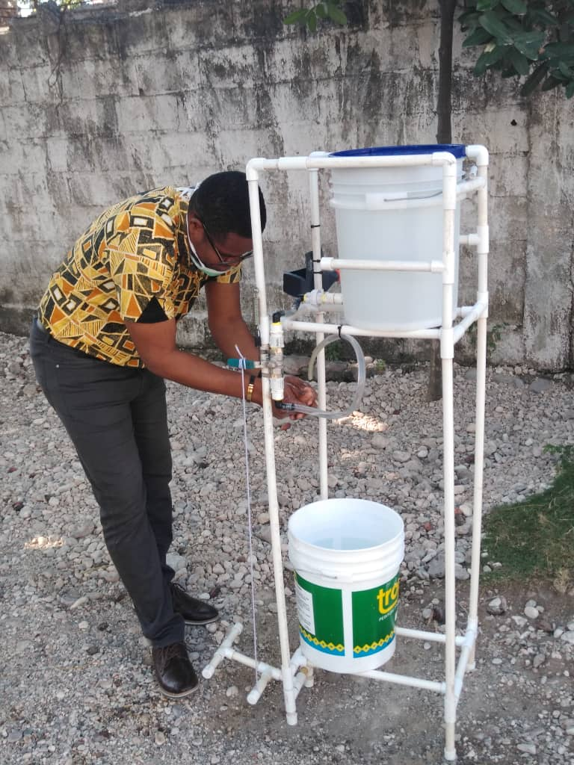
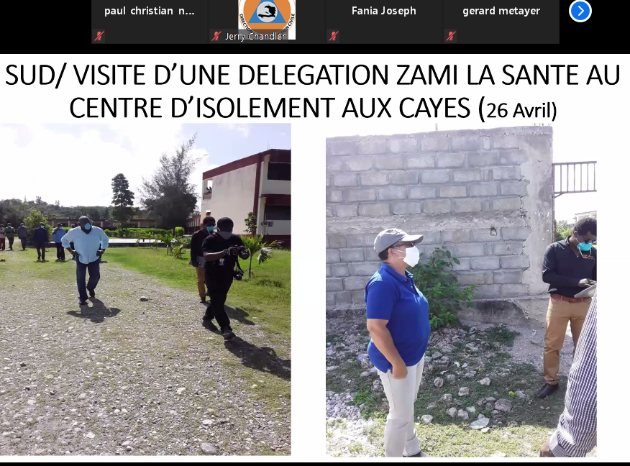
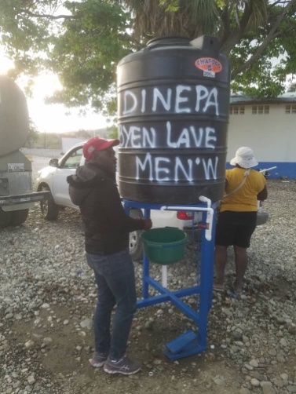
-
CoViD-19 WASH INTERVENTIONS - IMAGES
.
.
Notes:
Haiti is implementing 3-pronged strategy:
1-wash and health coordinating sensitization campaign, with sound trucks, individuals with megaphones,
hammering home key messages, juxtaposed with hand-washing stations with hygiene promoters, which are regularly supplied with water and soap.
2-Coordination of the water and sanitation component of CoViD-19 care facilities (over 40 opened or soon to be opened throughout Haiti,
targeting 7500-9000 beds in preparation for a case spike).
3-improved water (and, phased in, sanitation) access in geographically priority areas... particularly at rural border localities,
which can have important improvements at low cost, quickly implemented.
Consistent with observations made in forums (ex: WASH / CoViD-19 forums, World Bank, IADB, etc…) – conclusion that approach must be tailored to Global South’s reality in order to be effective

Slide 13
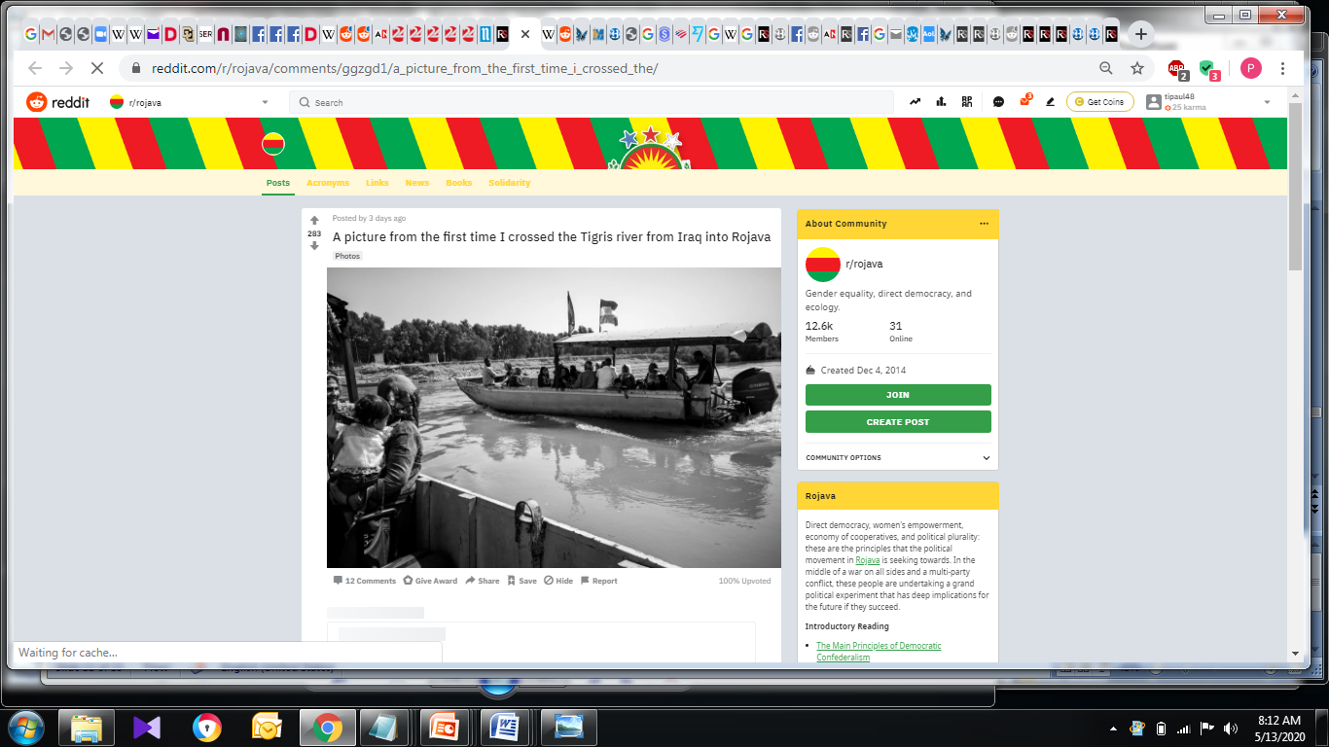

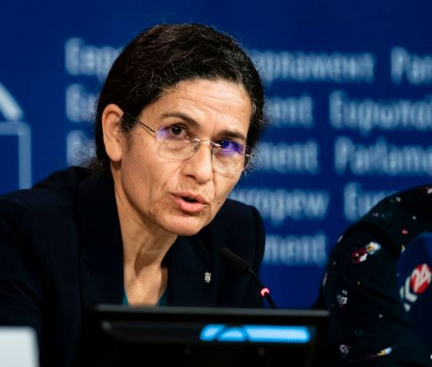


-
CASE COMPARISON:
HAITI VS. AANES/ROJAVA
Google Search “Reddit Rojava”, go to “Posts”, -->>Social Contract
CONNECTED W/ KURDISH FREEDOM MVT.
ROJAVA: Autonomous Administration NE Syria, led by SEC co-Pres. Ilham Ahmed.
Democratic Confederalism
(Direct Democracy, Jineoloji,/Women’s empowerment, Social+Environ.Ecology. )
Social contract-guided governance
Women and men leaders changing their autonomous society from within
Challenges: 1a-neo-Al Qaeda / ISIS , 1b-the Turkish invasion and occupation of parts of N. Syria…FINGERS ON THE SAME HAND!
2-Lack of cooperation from Damascus –based Syrian STATE+ international order
3-Resource and service sabotage (Turkey+ local allies of Turkey)
HAITI
Paradigm: courageous female / male individuals, making a difference
inside (MSPP, DINEPA, DPC) and outside (ZL/PIH, IJDH) the state realm
Limited capacity for positive results, b/c
Going against the institutional grain, re: domestic and int’l. decision-making processes.
AANES / ROJAVA
I. Ahmed
HAITI
Notes:
HAITI
Paradigm of courageous female and male individuals, making a difference inside (MSPP, DINEPA, DPC) and outside (ZL/PIH, IJDH) the state realm but in a general context severely limiting efficiency and positive results.
Going against a hostile “decision-making grain” of both domestic state actors, entrenched economic interests, and non-emergency international classical partnerships with scope not encompassing an uplifting of everyone
ROJAVA: Autonomous administration NE Syria. Fully motivated, dedicated women + men changing their society.
Governed by Democratic Confederalism (Direct Democracy, Jineoloji, Soc.+Env. Ecology. Social contract-guided governance
* Hampered by 1-neo-Al Qaeda / ISIS forces, 2-the Turkish Occupation of parts of N. Syria, 3-an uncooperative-to-hostile regime in Damascus, 4-an unsympathetic, non-reciprocating international order.
3 current challenges (invasion, ressource sabotage, non-cooperation).

Slide 14
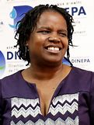
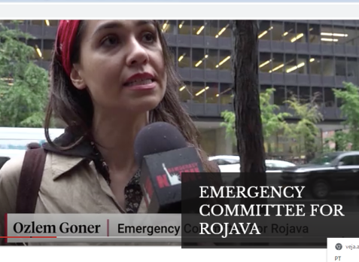
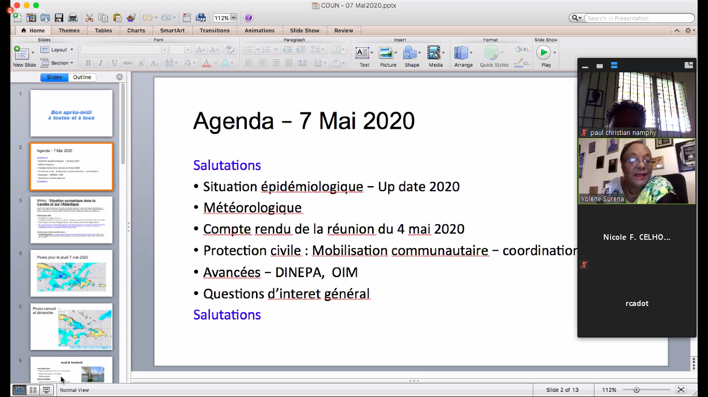
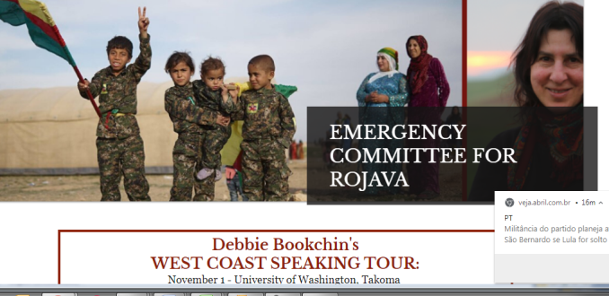
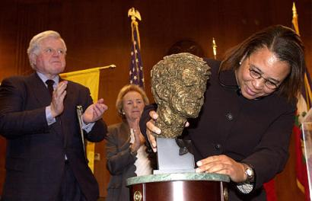
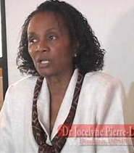
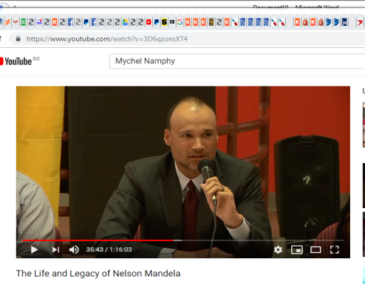

-
ACKNOWLEDGEMENTS
.
THANK YOU, ALL PARTIES WHO ARE MAKING A DIFFERENCE!
NY-based Emergency Committee for Rojava: Ozlem Goner and Debbie Bookchin!
In loving memory, mother and brother Mychel Namphy, CUNY York Literature Prof. Queens
HAITI: Edwige Petit, DINEPA
Jocelyne B. Pierre-Louis, Health Ministry
Dr. Yolene Surena, COUN/SPGRD
Loune Viaud, ZL/PIH
SOPUDEP, SOIL, so many others!
Notes:
We come from a long line for fighters in the struggle for change, in Haiti, in the US, and abroad.

Slide 15
-
SOURCES:
https://www.huffingtonpost.ca/entry/ice-deportations-haiti-covid-19_n_5eb86e11c5b6d34558aec139?ri18n=true
https://www.miamiherald.com/news/local/immigration/article242645496.html
https://www.miamiherald.com/news/local/immigration/article242637741.html
https://www.reddit.com/r/rojava/comments/7oq8y9/this_is_how_the_democratic_system_of_rojava_works/
https://www.reddit.com/r/rojava/comments/8br9q8/social_contract_of_the_dfns_in_english_and_other/
https://jineoloji.org/en/
https://komun-academy.com/2018/06/27/what-is-jineoloji/
https://internationalistcommune.com/jineoloji-the-science-of-womens-liberation-in-the-kurdish-movement/
https://komun-academy.com/2018/11/22/the-main-principles-of-democratic-confederalism/
https://en.wikipedia.org/wiki/Rojava
https://www.ft.com/content/50102294-77fd-11e5-a95a-27d368e1ddf7
https://komun-academy.com/2019/01/09/the-life-of-sakine-cansiz-realizing-utopias-here-and-now/
See Description of “Democratic Confederalism” in Wikipedia’s article on Abdullah Ocalan
MSPP and IOM internal documents
.
Notes:
-In CoViD-19 crisis, it is the sheer dedication of committed women and men, and advocacy organizations expressing international solidarity, that has achieved the positive objectives that we have witnessed
-The contradictions of the State, and of the International Order, existing prior to the arrival of CoViD-19, are playing out currently, in new ways, and posing major challenges to survival and livelihood.
-International solidarity among universities and activist organizations is key to achieving positive outcomes (life-saving, promotion of well-being and dignified livelihoods) among CoViD-19 populations of the Global South – and in your own communities

Slide 16
-
SOURCES: CONT’D 28 books describing, or being, events that changed / are changing the course of humanity
28-Enheduanna (Princess, Priestess, Poet), The Sumerian Temple Hymns, ca. 2300 BC.
2,3,4-The Torah, The Bible, The Qur’an, NOT EXHAUSTIVE.
5-Sappho, (poetic works written ca. 605-570 BC, translated by Mary Barnard)
6-Egeria, The Pilgrimage of Etheria, 380’s
7-John Locke, TWO TREATISES OF GOVERNMENT, 1689
8-Jean-Jacques Rousseau, On the Social Contract, 1762
9-Adam Smith, THE WEALTH OF NATIONS, 1776
10,11-Karl Marx, The COMMUNIST MANIFESTO, 1848, and DAS KAPITAL, 1867
12-C.L.R James, THE BLACK JACOBINS: TOUSSAINT L'OUVERTURE AND THE SAN DOMINGO REVOLUTION, 1963 (subject: HAITI)
13,14,15-Murray Bookchin, THE ECOLOGY OF FREEDOM, 1982, THE POLITICS OF SOCIAL ECOLOGY – LIBERTARIAN MUNICIPALISM, 1997, and SOCIAL ECOLOGY AND COMMUNALISM, 2007 (posthumous)
16-24-Paul Farmer + N. Chomsky, (also see next slide) J.B. Aristide, A. Goodman, W.J. Clinton, T. Kidder, J.W. Block, Gustavo Gutierrez, and others: 13-THE USES OF HAITI, 1994, 14-IN THE PARISH OF THE POOR 1990, Getting Haiti Right This Time: The U.S. and the Coup, 2004, 15-PARTNER TO THE POOR – A P.F. READER, 2010, 16-P.F. SERVANT TO THE POOR, 2018, 17-IN THE COMPANY OF THE POOR, 2013, 18-PATHOLOGIES OF POWER, 2017, 19-MOUNTAINS BEYOND MOUNTAINS, 2003, 20-TO REPAIR THE WORLD, 2013
25-Abdullah Ocalan, The Political Thought of Abdullah Öcalan: Kurdistan, Woman's Revolution and Democratic Confederalism, 2017
26-27- Sara: My Whole Life Was a Struggle; and Sara: Prison Memoir of a Kurdish Revolutionary, English translations by Janet Biehl 2018 2019.
28-SOCIAL CONTRACT OF THE DEMOCRATIC FEDERATION OF NORTHERN SYRIA, 2014
.
Notes:
-In CoViD-19 crisis, it is the sheer dedication of committed women and men, and advocacy organizations expressing international solidarity, that has achieved the positive objectives that we have witnessed
-The contradictions of the State, and of the International Order, existing prior to the arrival of CoViD-19, are playing out currently, in new ways, and posing major challenges to survival and livelihood.
-International solidarity among universities and activist organizations is key to achieving positive outcomes (life-saving, promotion of well-being and dignified livelihoods) among CoViD-19 populations of the Global South – and in your own communities

